Slide 1

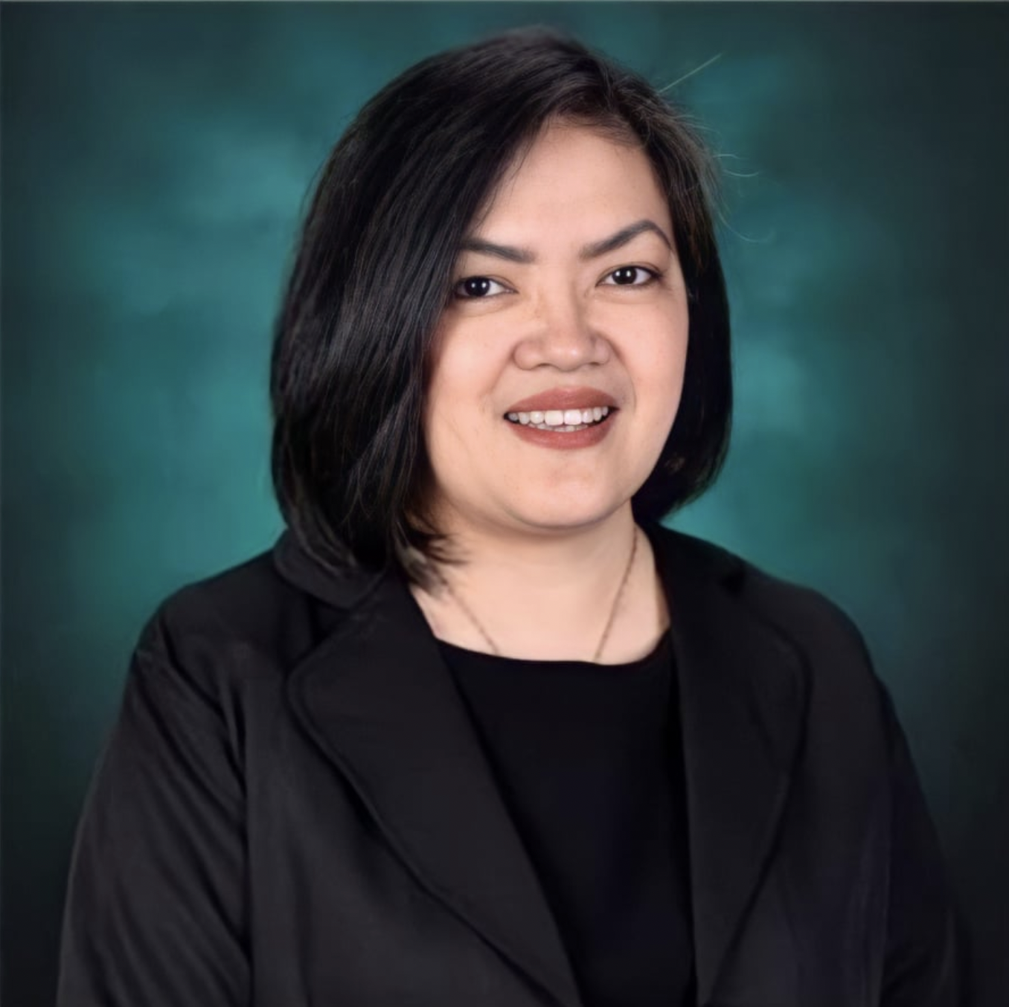
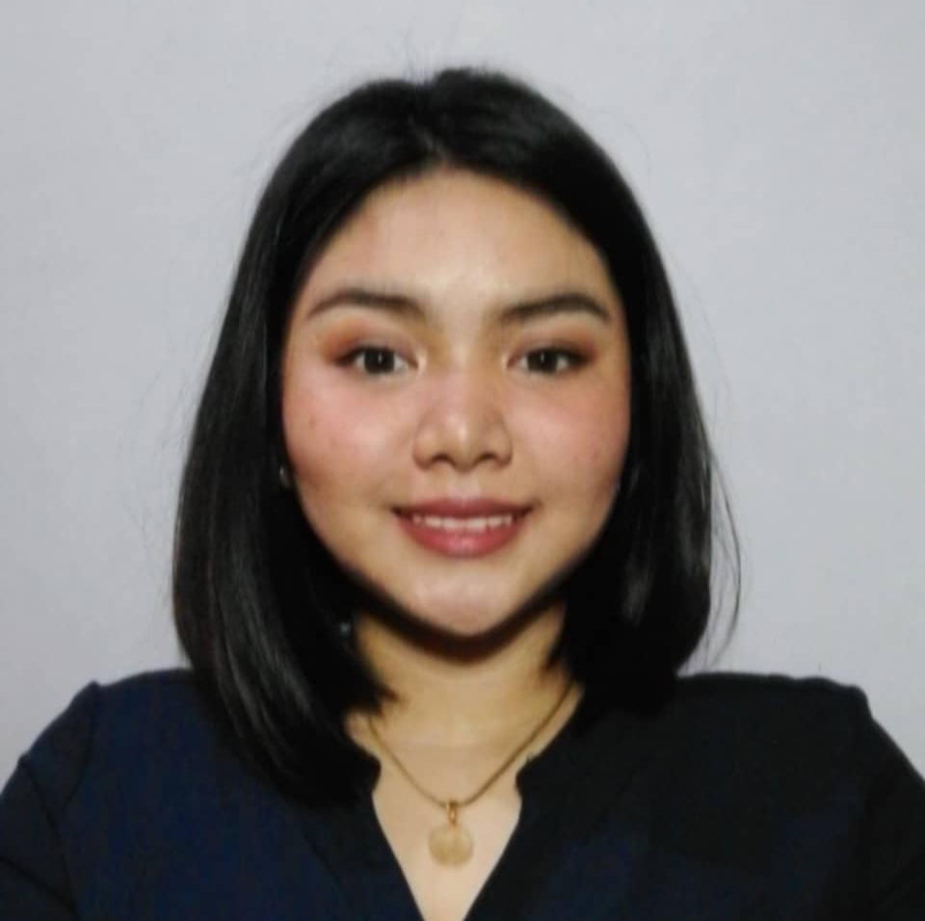
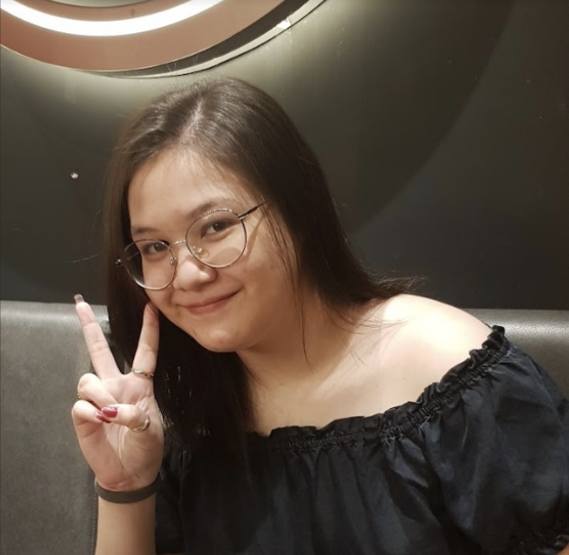




Jo Anne M. de la Cuesta
Project Adviser
Alyssa L. Garcia
Erin R. Camino
Lead Developer
Stakeholder
Roselle Wednesday Gardon
Project Consultant
Andre O. Viernes
Team Leader/ Scrum Master
Dan Michael C. Alfaras
Kevin Josef Banglagan
Product Owner
Developer

Slide 2

Sneak Peek
D7 Auto
Service Center
About D7 ASC
Current System
Client’s Problem

Slide 3
D7 Auto Service Center Background
FB as
Platform &
onsite services
D7 Auto
Service Center
Anne Sydney
Simpelo
16 years in
the industry
Automobile Repair
Industry

Slide 4
D7 Auto Service Center Background
Uploading
Posts
Management takes photos of servicing
Management posts the photos and services
Answering
Inquiries
Checks for customer inquiries on Facebook
Responds to customer inquiries on Facebook
On-site
Payment
Payments happen on-site
Service Reservation
Accepts reservation request on-site
and through FB messenger

Slide 5
D7 ASC Problem.pdf
What is the problem of
D7 Auto Service Center?
Page 1 of 2

Slide 6
D7 ASC Problem.pdf
D7 Auto Service Center is having difficulties in advertising and building online presence.
D7’s competitors continue to rise around the area, and even online.
Troubled in catching up with the ways, competitors are doing to standout.
Page 2 of 2

Slide 7

Sneak Peek
About D7 ASC
D7 Auto
Service Center
Current System
Client’s Problem

Slide 8


Objective
Project
Scope
RRS
Significance
How will the team address these problems?

Slide 9

Objective
Project
Scope
RRS
Significance
Main Objective
To help D7 Auto Service Center develop an additional platform that aims to extend the online presence of the business.

Slide 10
Objective
Project
Scope
RRS
Significance
Main Objective
To help D7 Auto Service Center develop an additional platform that aims to extend the online presence of the business.
Ensuring that the additional platform will also have functionalities that will help D7, not only in building online presence, and advertising, but also in managing their business, to maximize what they can do in the new platform!

Slide 11
Objective
Project
Scope
RRS
Significance
Specific Objectives
To add online presence through the creation of a web-app.
To resolve the informal reservation process by means of adding a reservation system in the web-app.
To provide options of payment by means of including an online payment system in the web-app.
To include statistics as a feature in the web-app that has information comparisons to help in making informed decisions for the business.

Slide 12

Objective
Project
Scope
RRS
Significance
D7 Auto Service Center’s
Web-Application

Slide 13
Objective
Project
Scope
RRS
Significance
Promos &
Services
Online Booking
System
Live Chat
Online Payment
System
Support
Tab
360 Virtual Tour
D7 Auto Service Center’s
Web-Application
Statistics
Reports
Bot Chat

Slide 14
Objective
Project
Scope
RRS
Significance
Scope and Limitation
The project is limited to and focused on creating a web-app as platform for the advertising and managing of the services of D7 Auto Service Center. Providing features that are tailor-fit to the client’s needs, and features that will be innovative vs. D7’s current system.

Slide 15
Objective
Project
Scope
RRS
Significance
Related Systems Review
The team was able to review related systems to the project, and in response to this, there are plenty of features that are being used by the systems such as directions, social media buttons, & list of services.
The project D7 web-app was able to have features that weren’t present in the systems reviewed. Those being:
360° Virtual Tour
Support Tab
Bot Chat

Slide 16
Objective
Project
Scope
RRS
Significance
Significance of the project
The project will be of great help in building online presence and value to the business of D7 Auto Service Center, while it also adds helps in making transactions, managing bookings, viewing payments, monthly performance statistics, and responding to inquiries to be all in one place.
Compliant to SDG no. 9 - Innovation

Slide 17
Sneak Peek
About D7 ASC
D7 Auto
Service Center
Current System
Client’s Problem

Slide 18

View System Analysis and Design

Slide 19
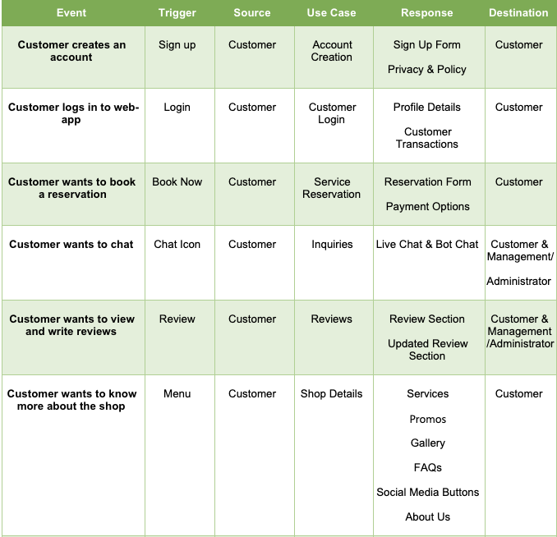
Event Table

Slide 20
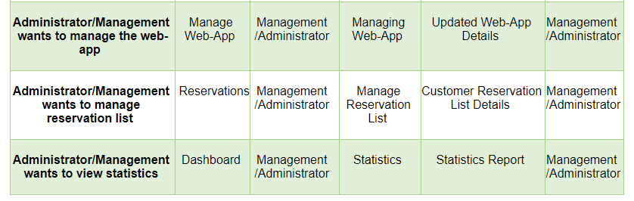

Slide 21
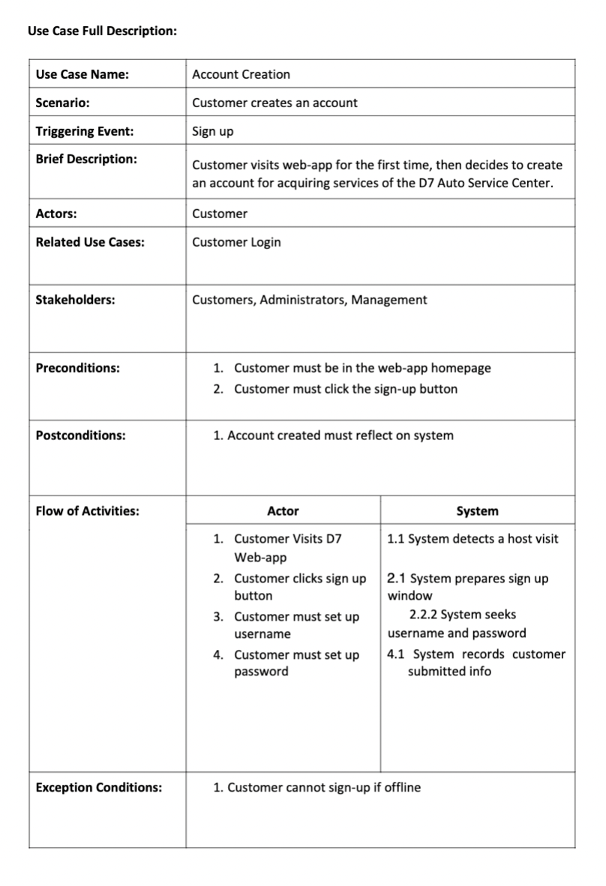
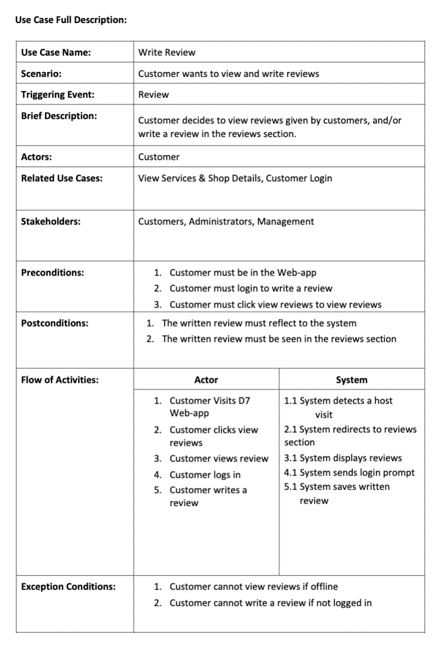

Slide 22
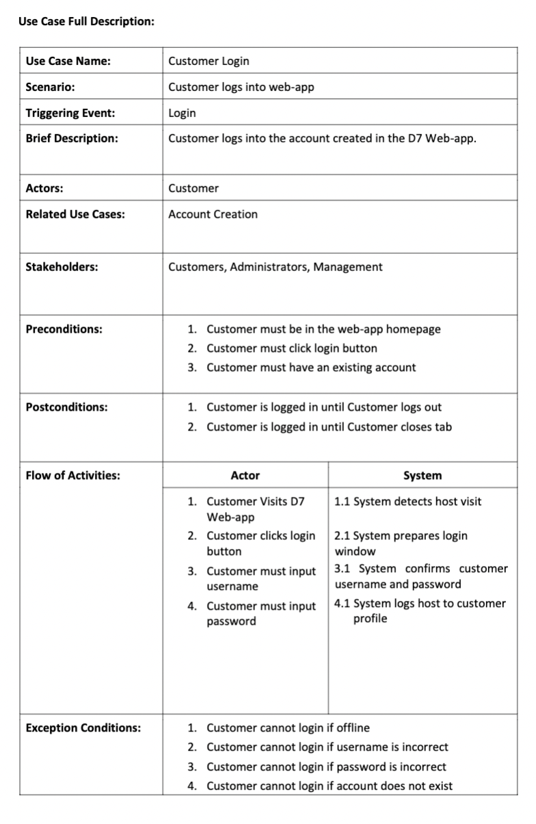
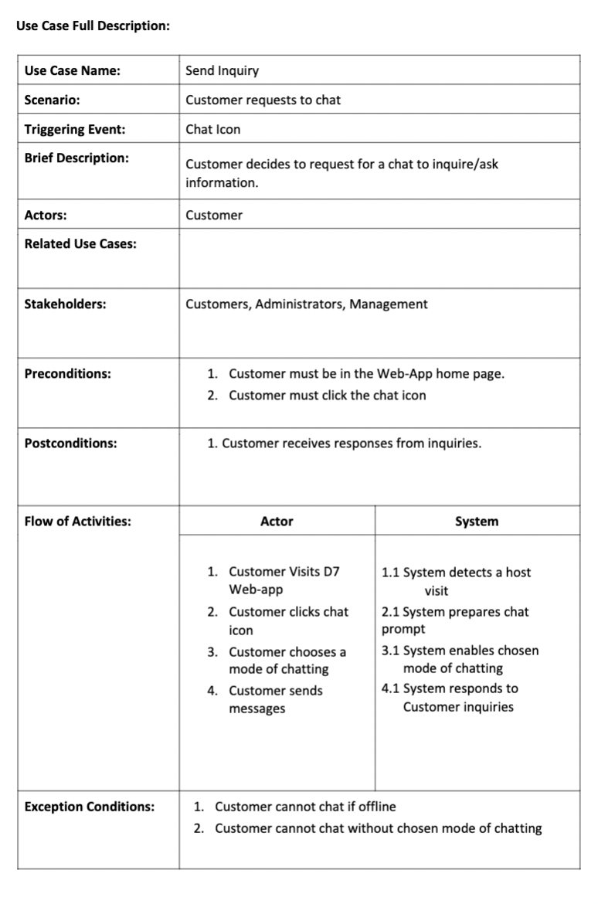

Slide 23
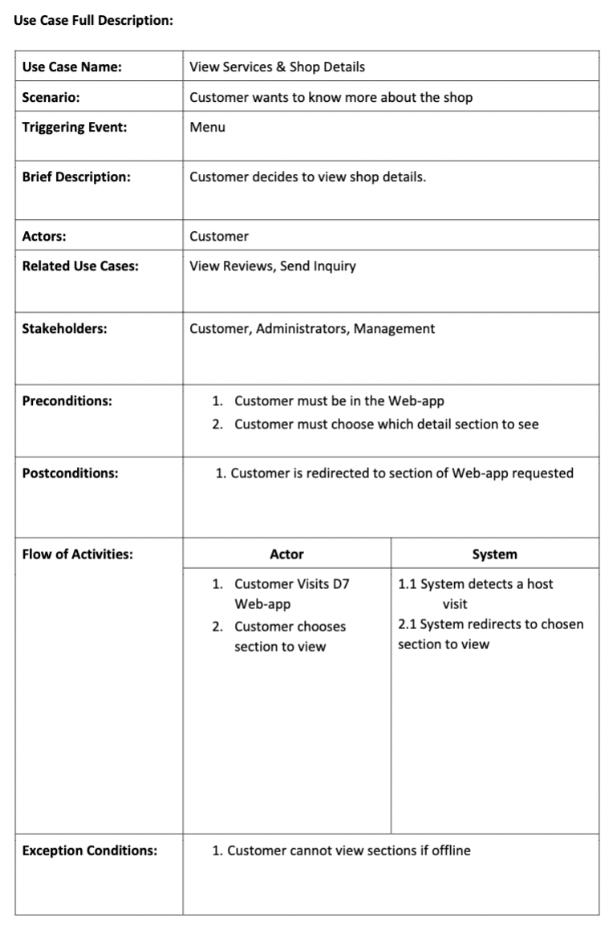
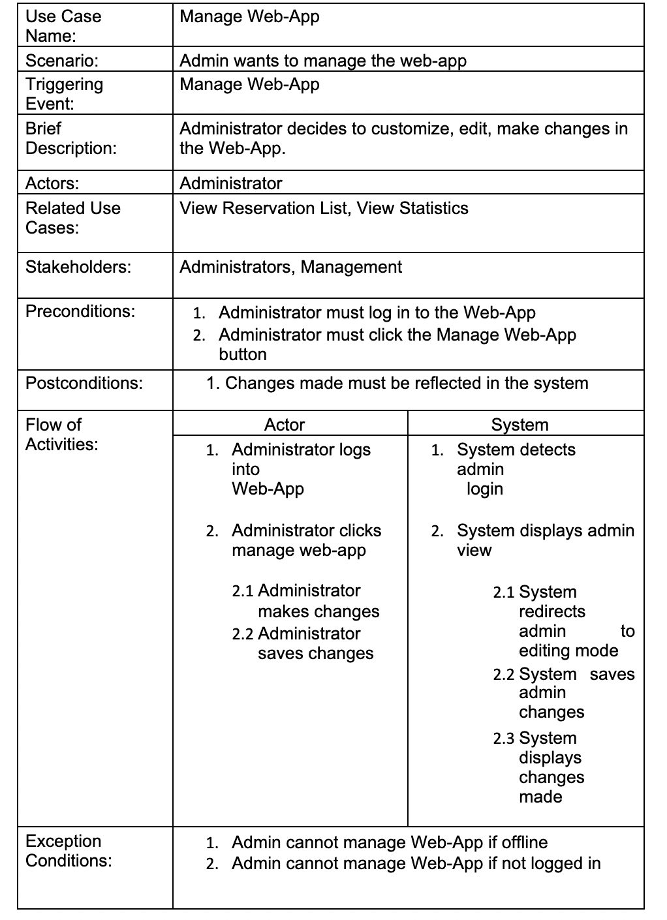

Slide 24
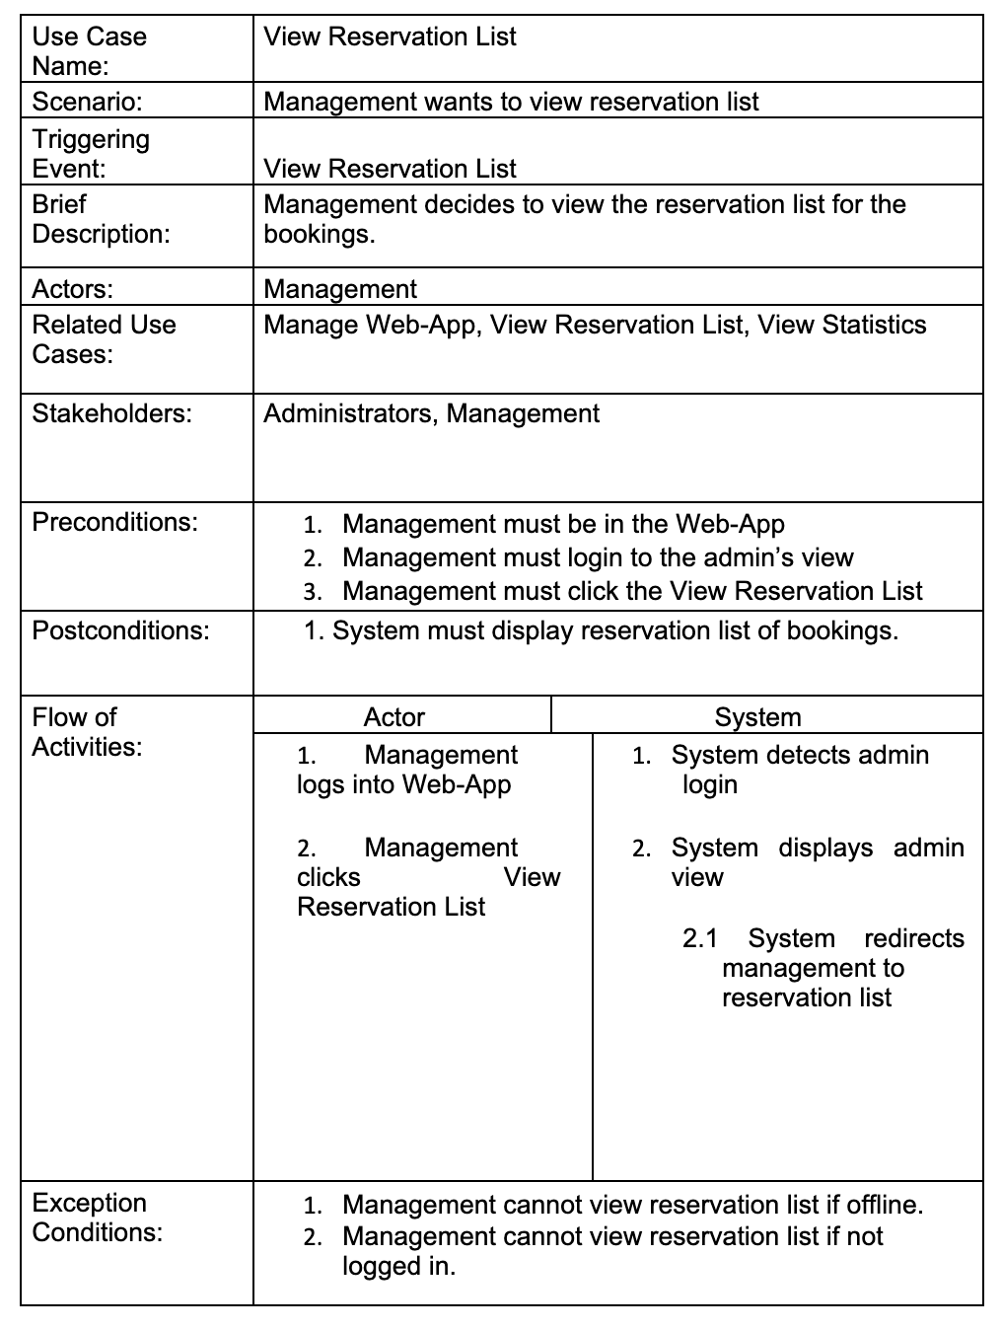
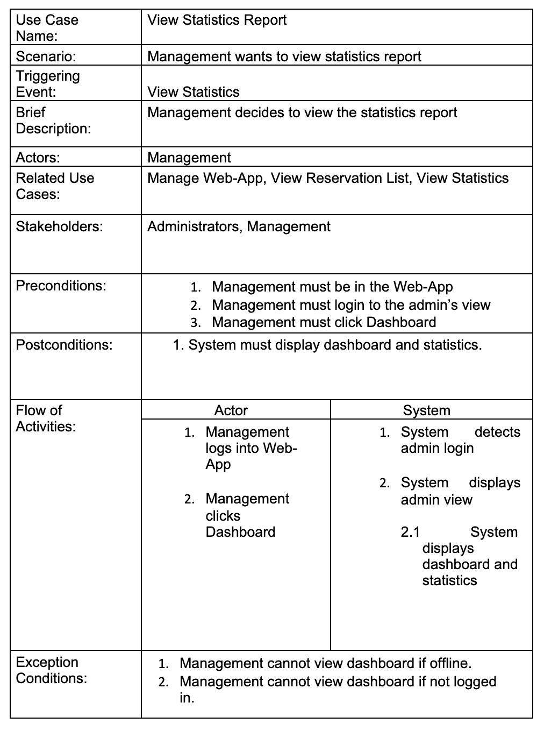

Slide 25
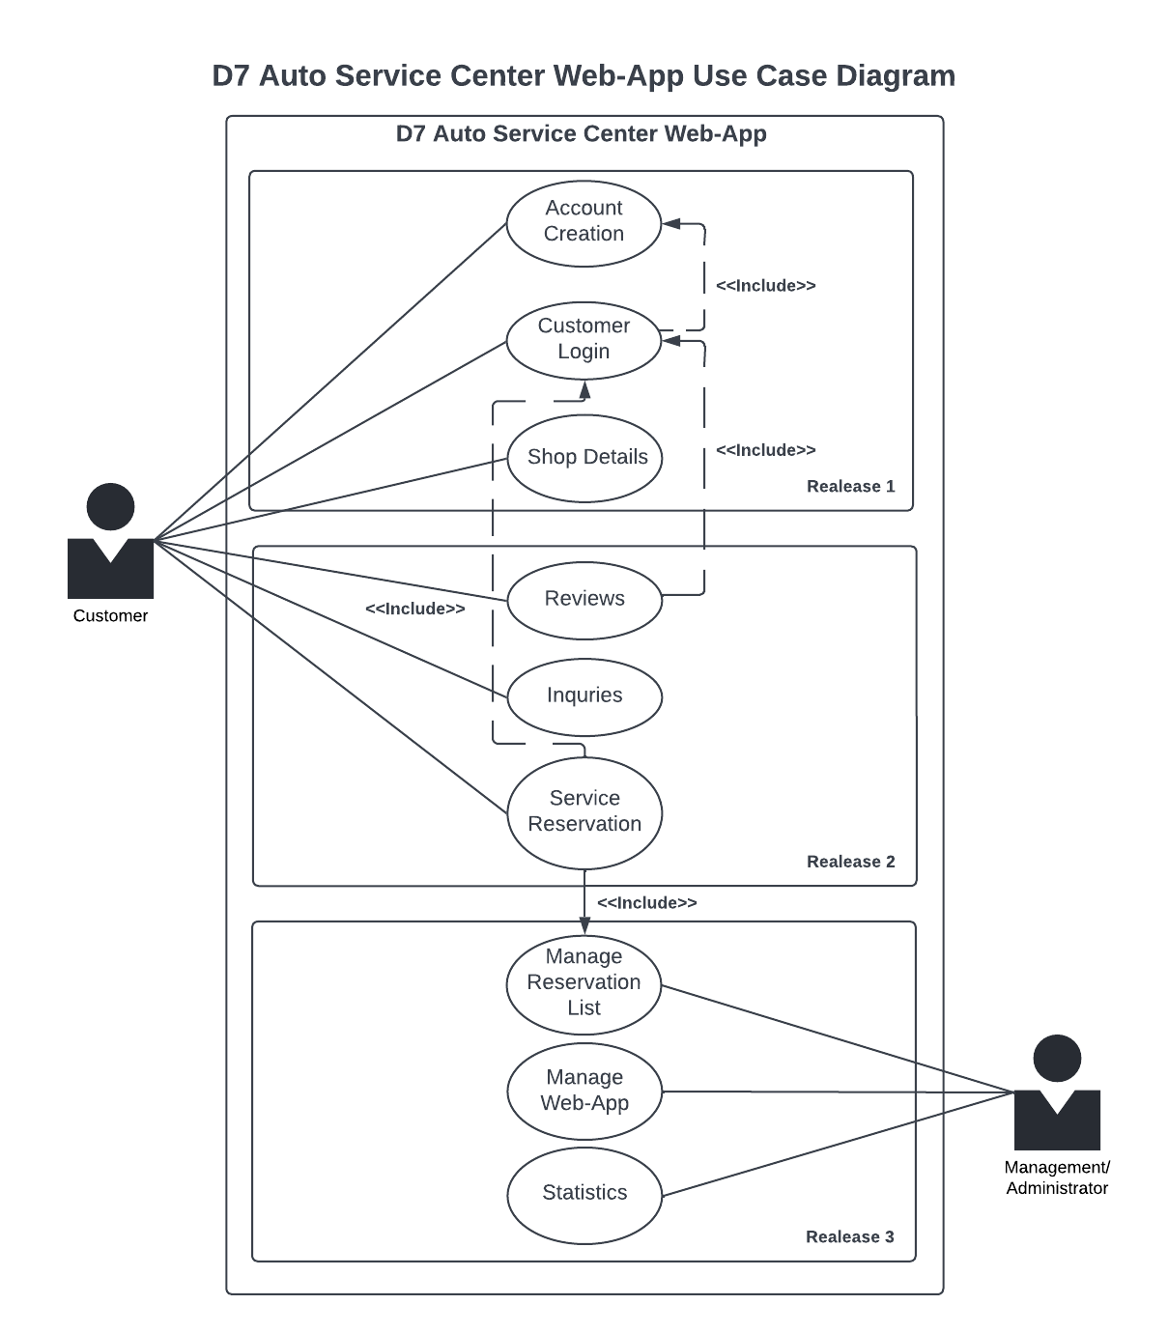

Slide 26
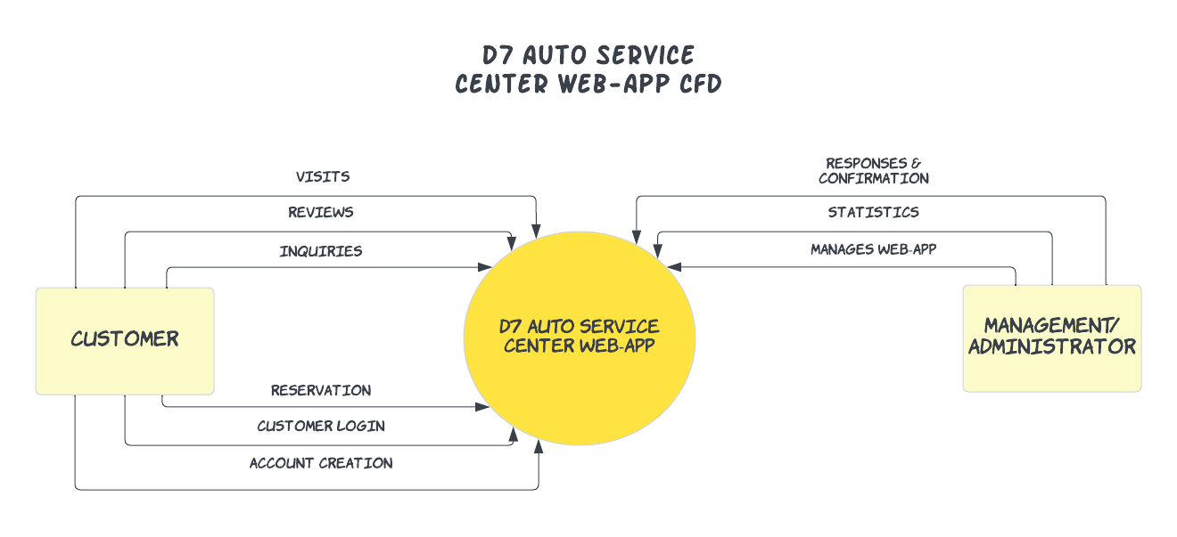

Slide 27
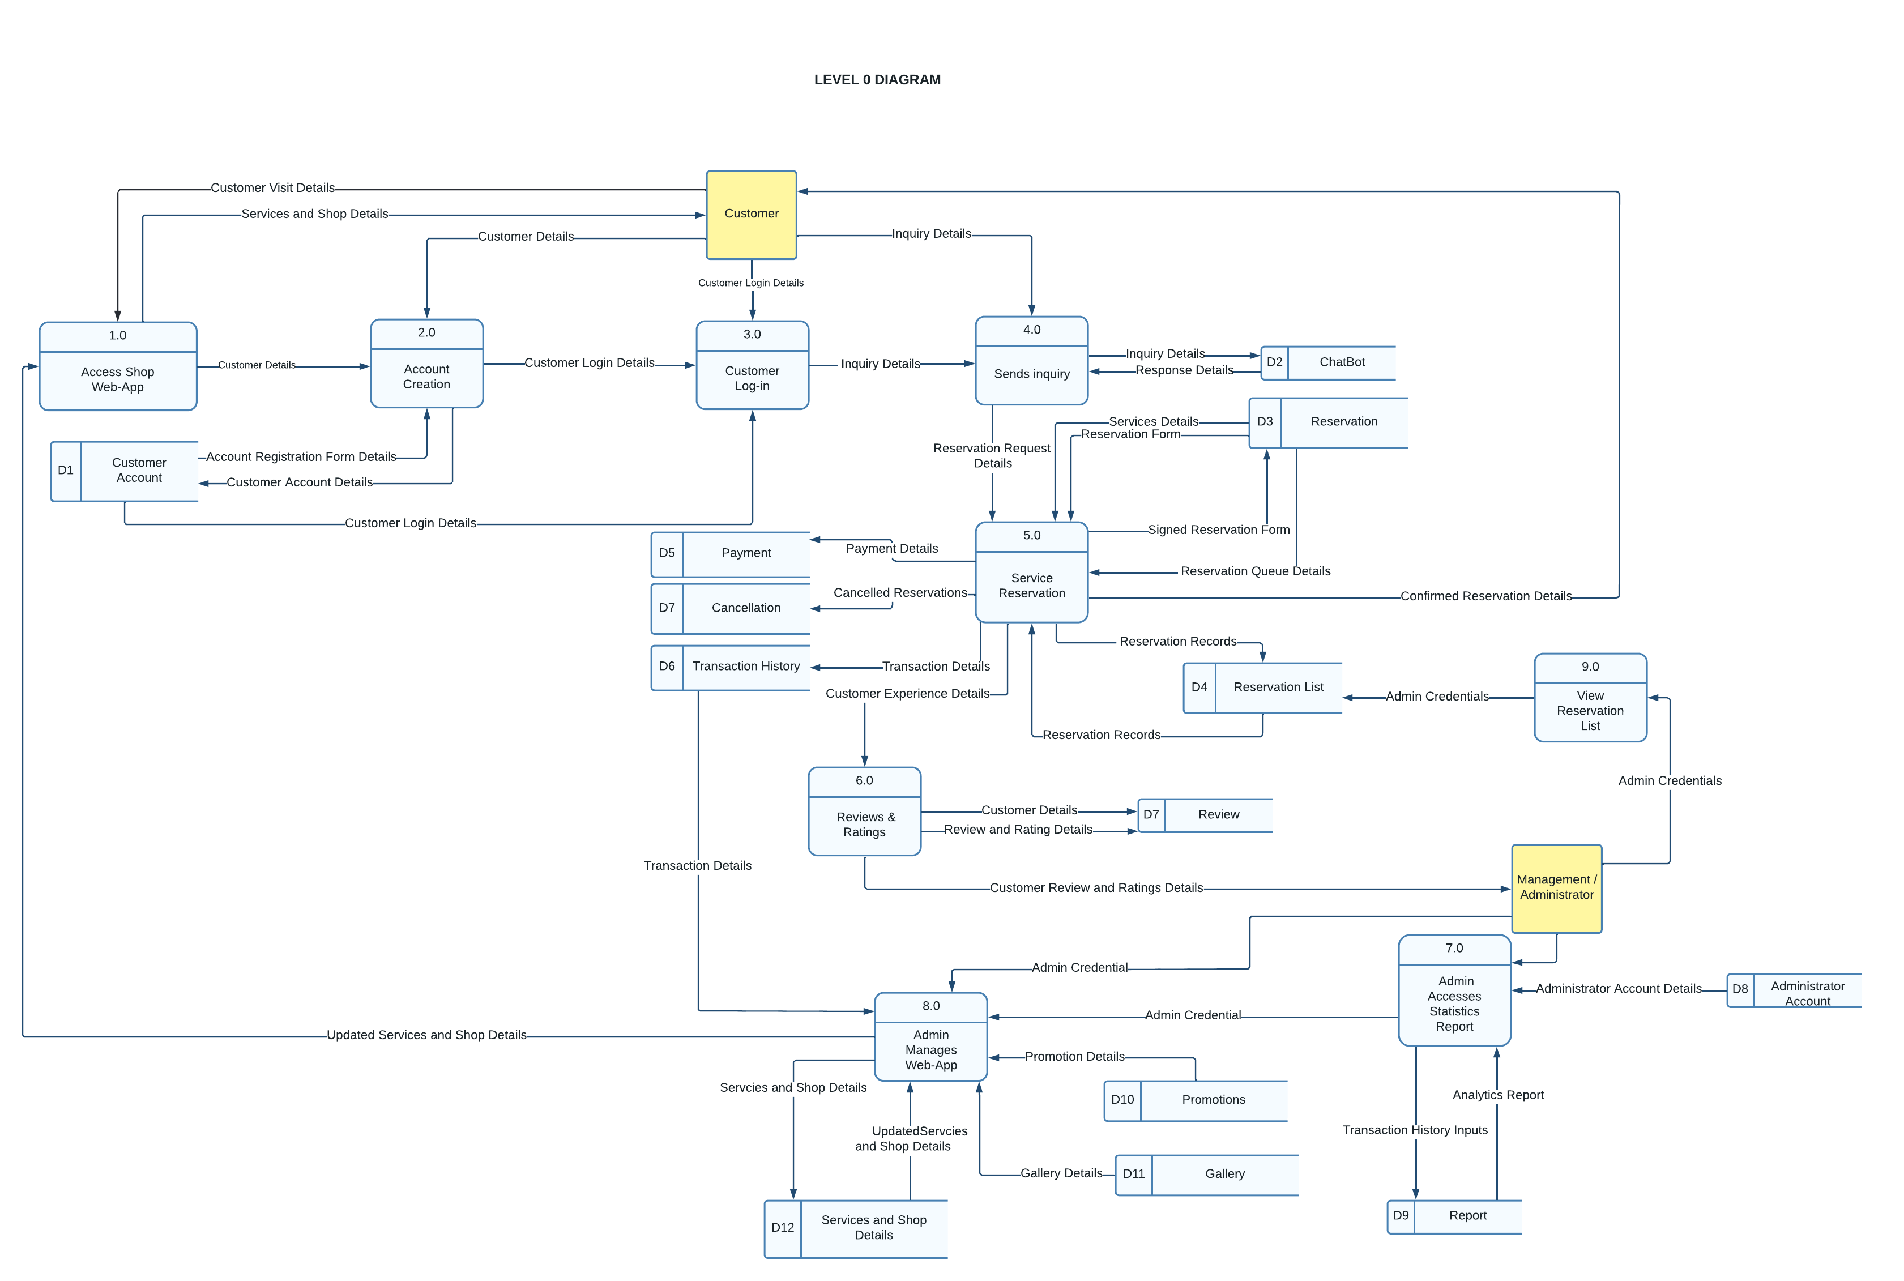

Slide 28
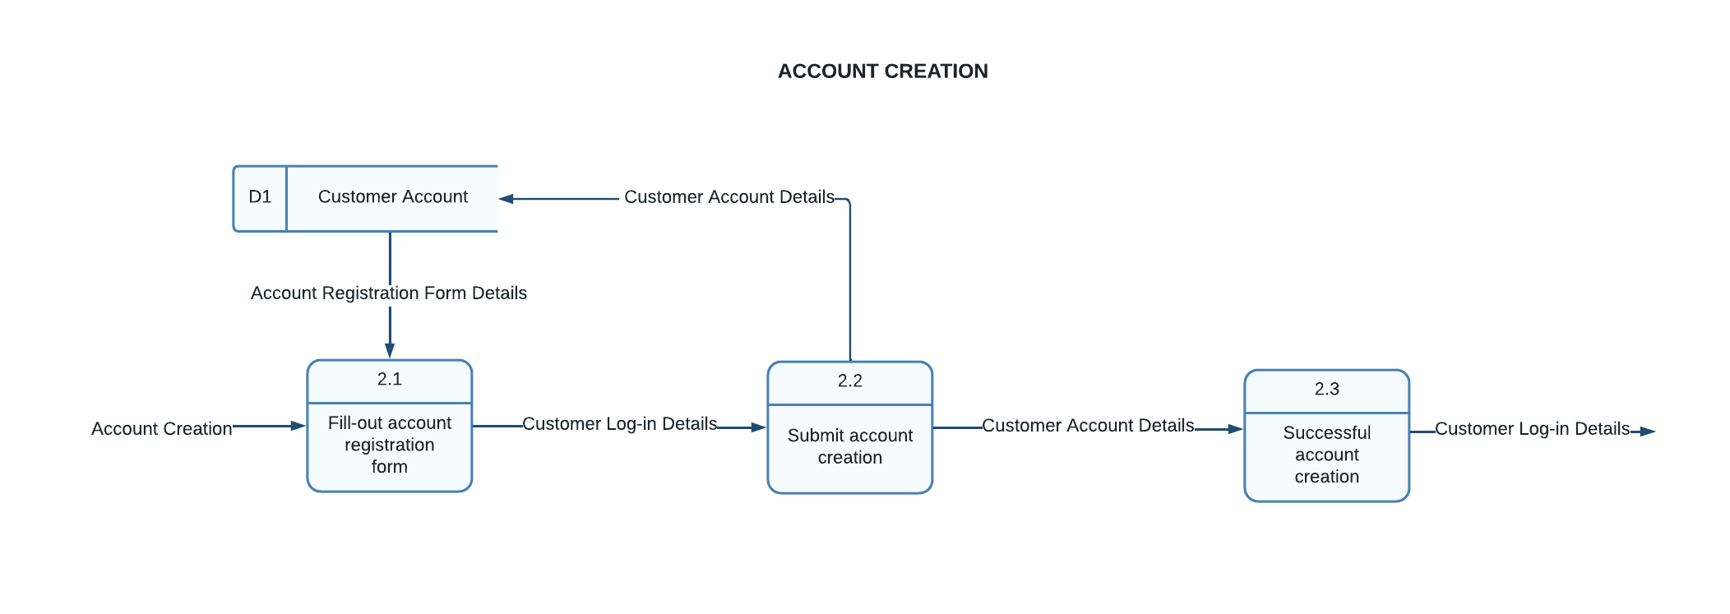
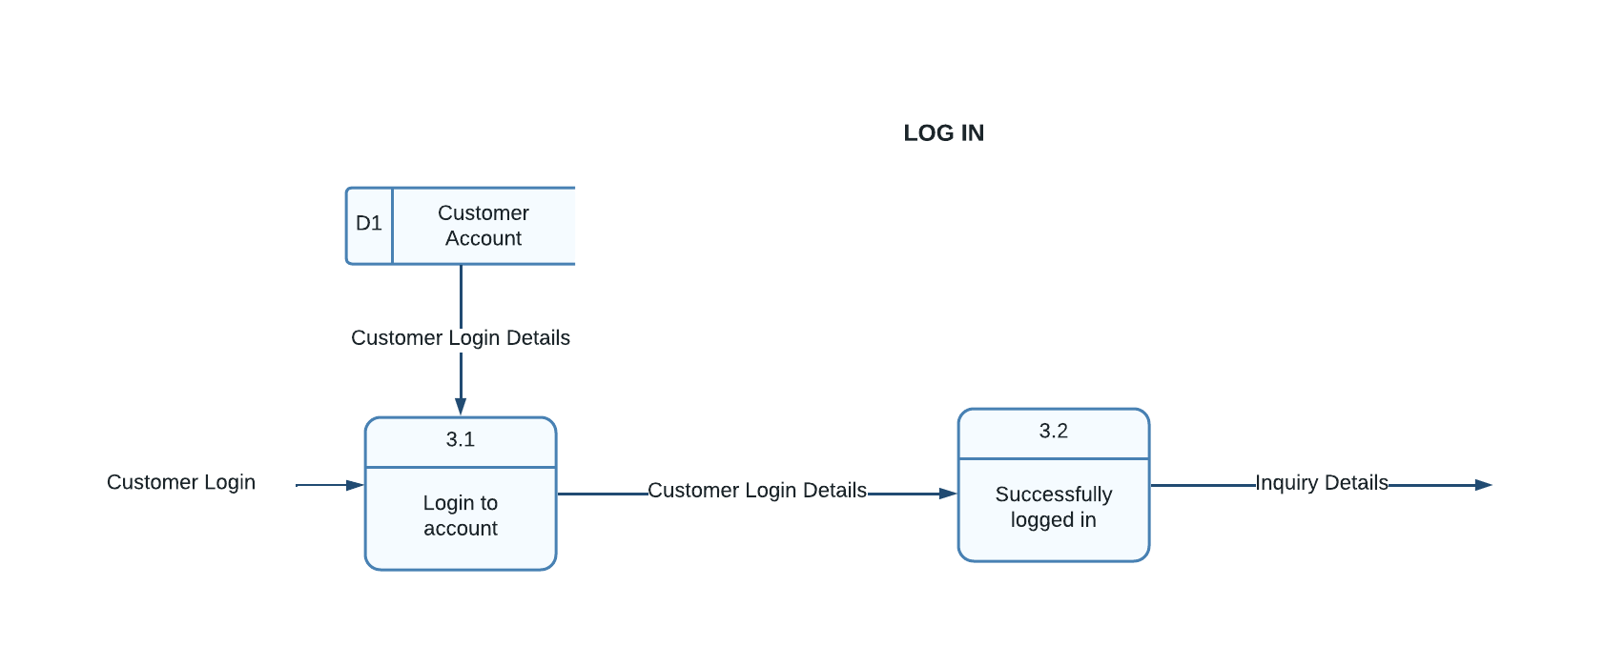

Slide 29
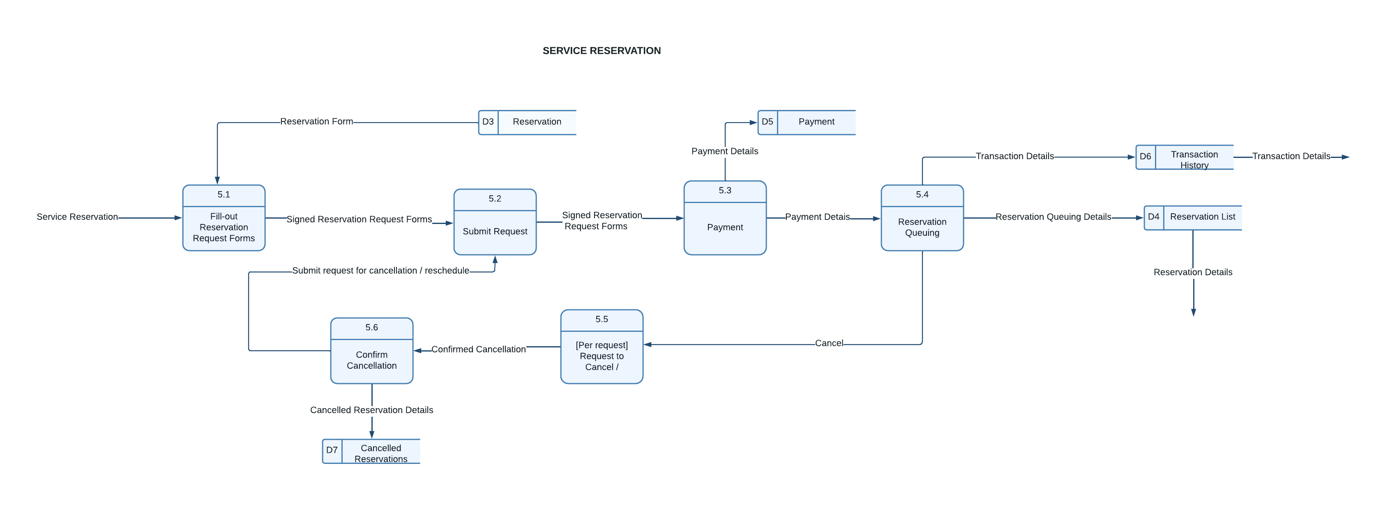

Slide 30
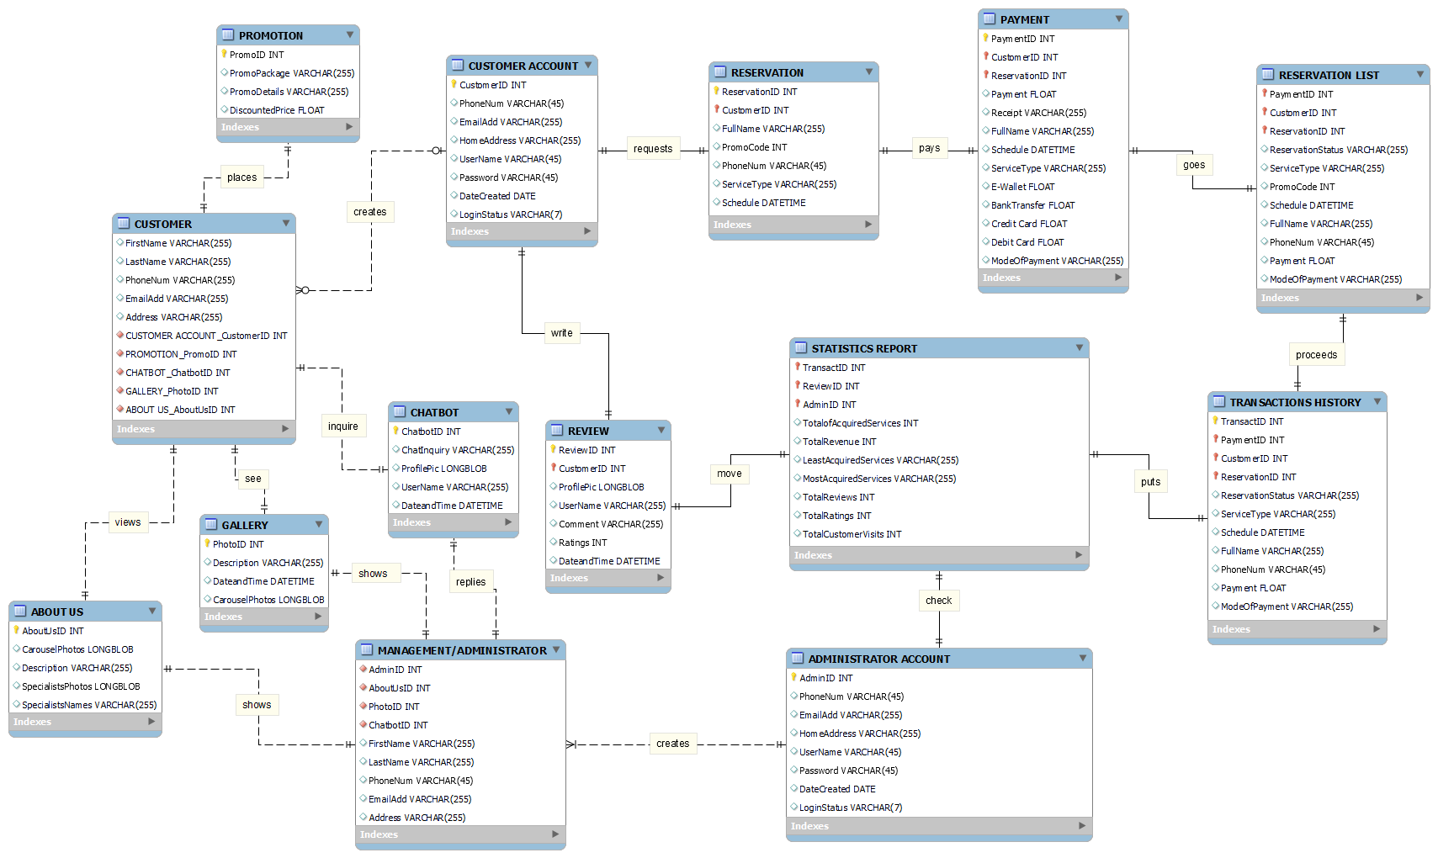
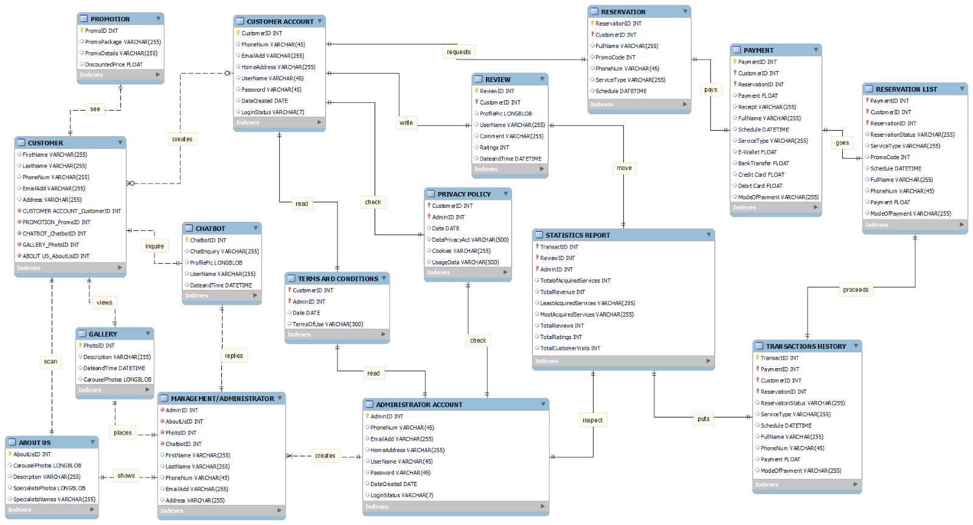
Entity Relationship Diagram
erd

Slide 31
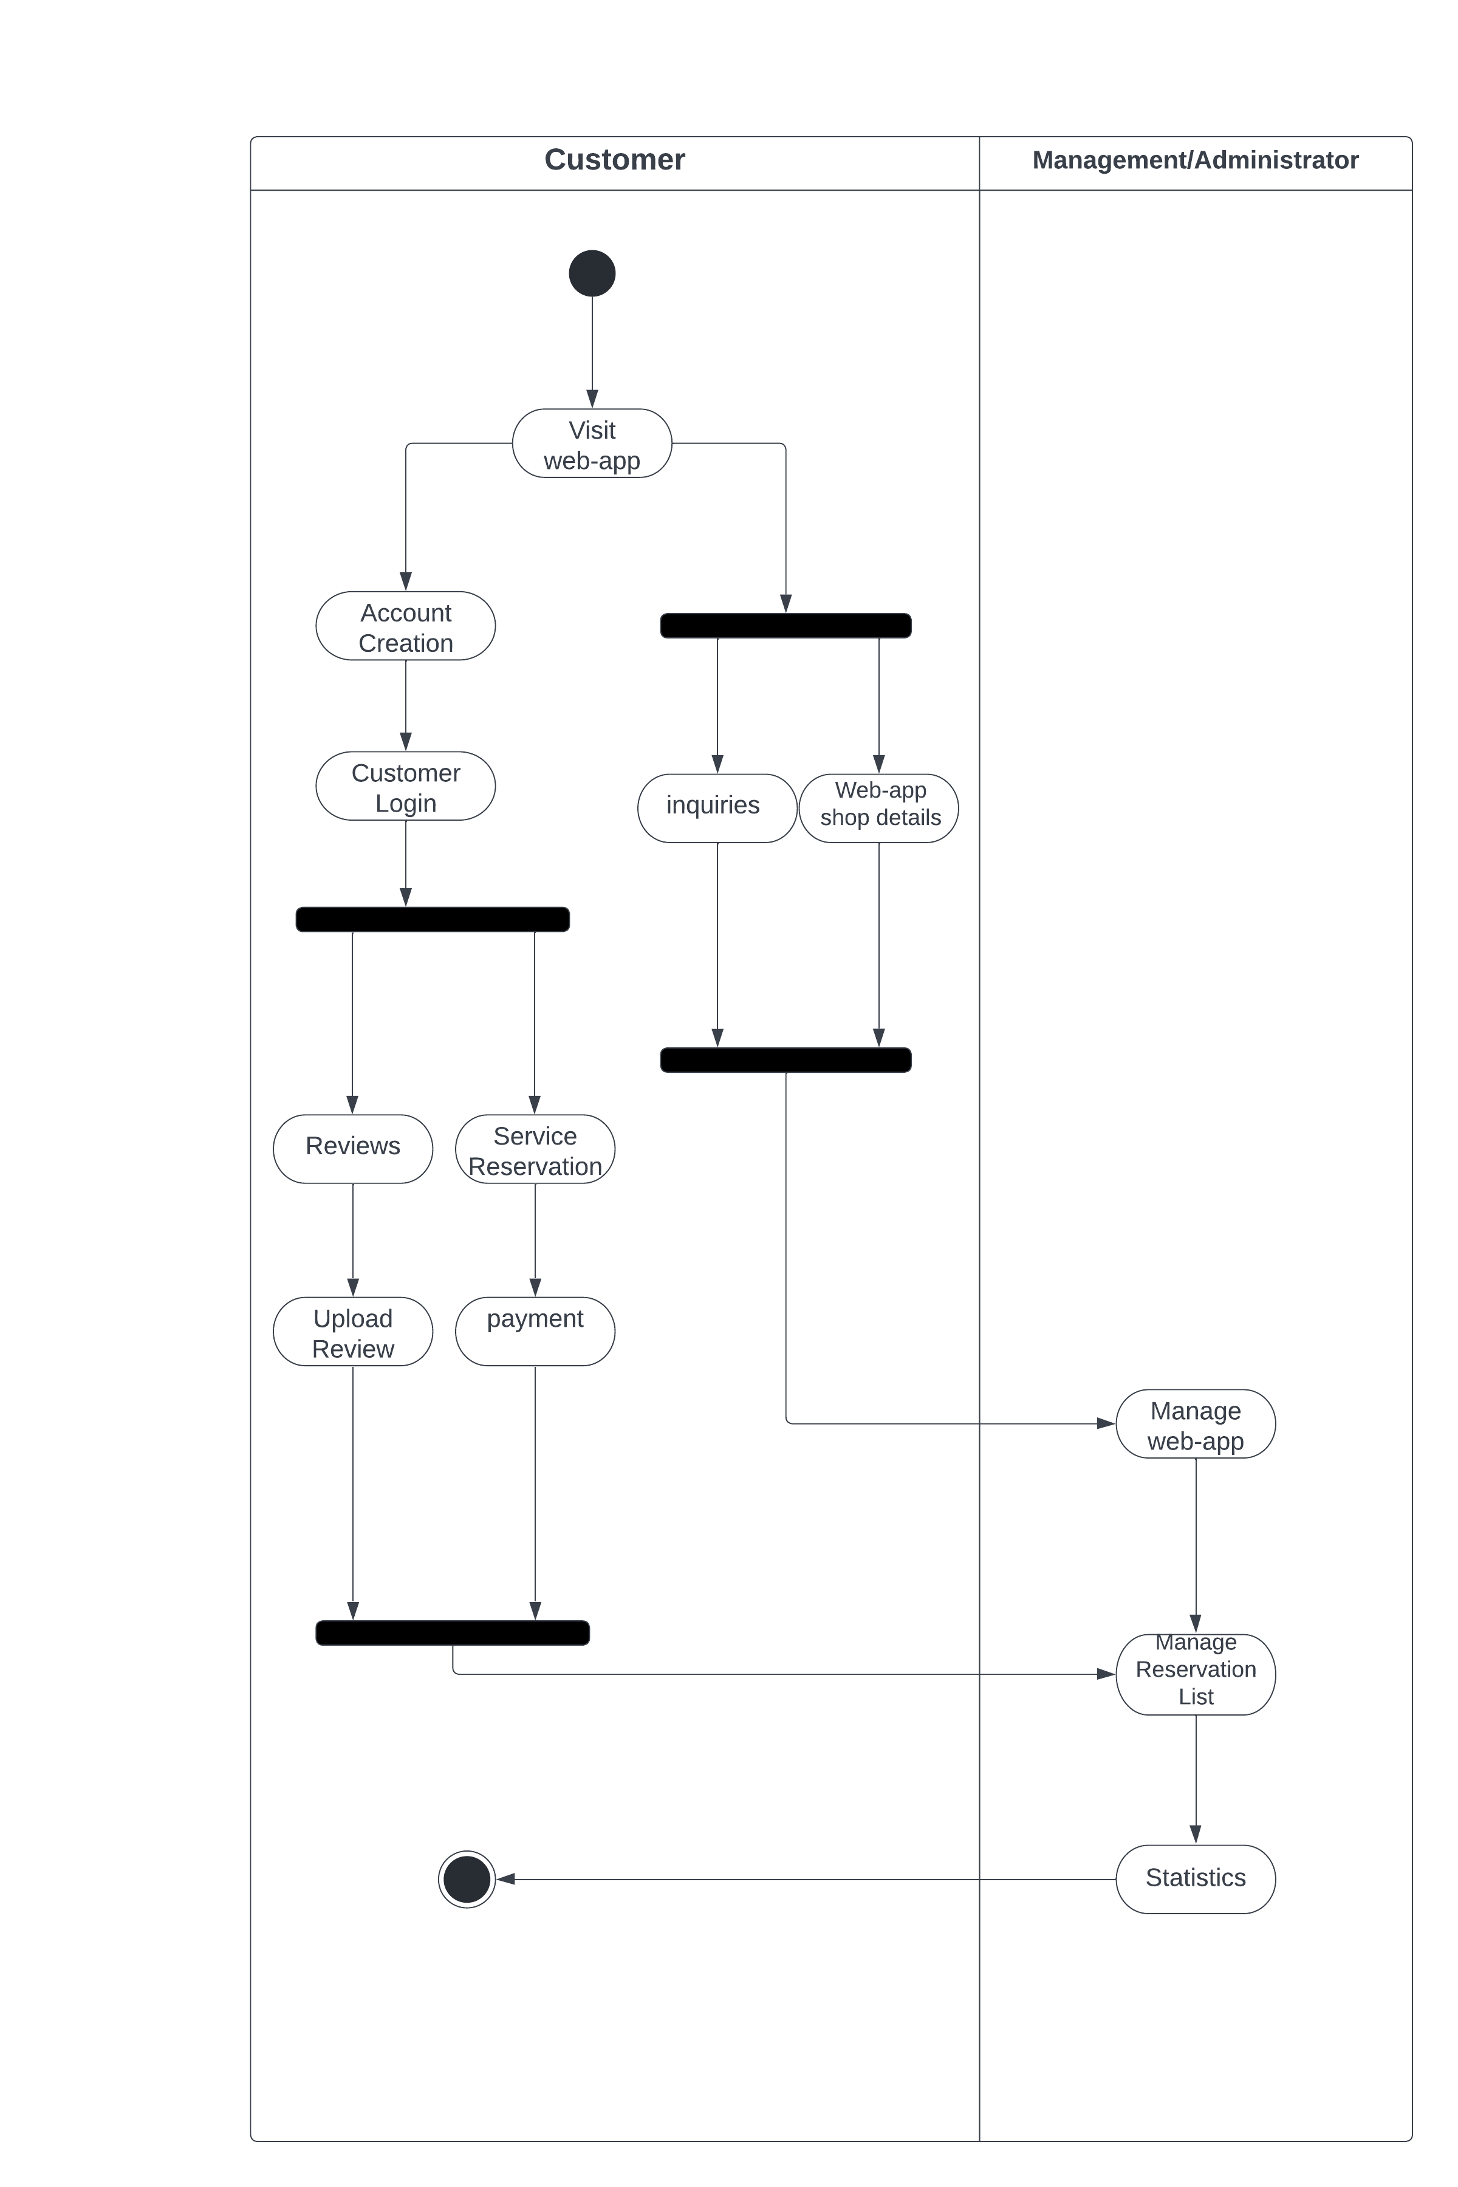
Activity Diagram

Slide 32
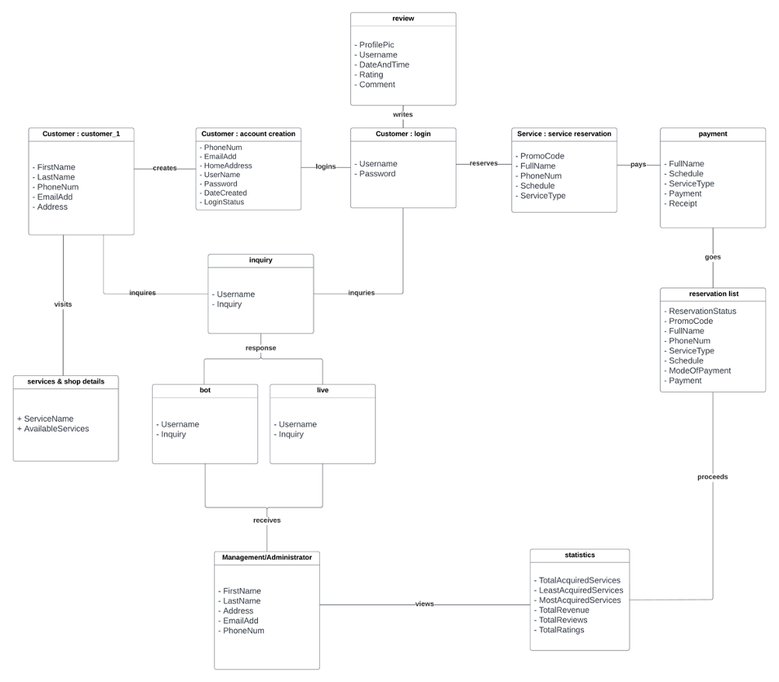
Object Diagram

Slide 33
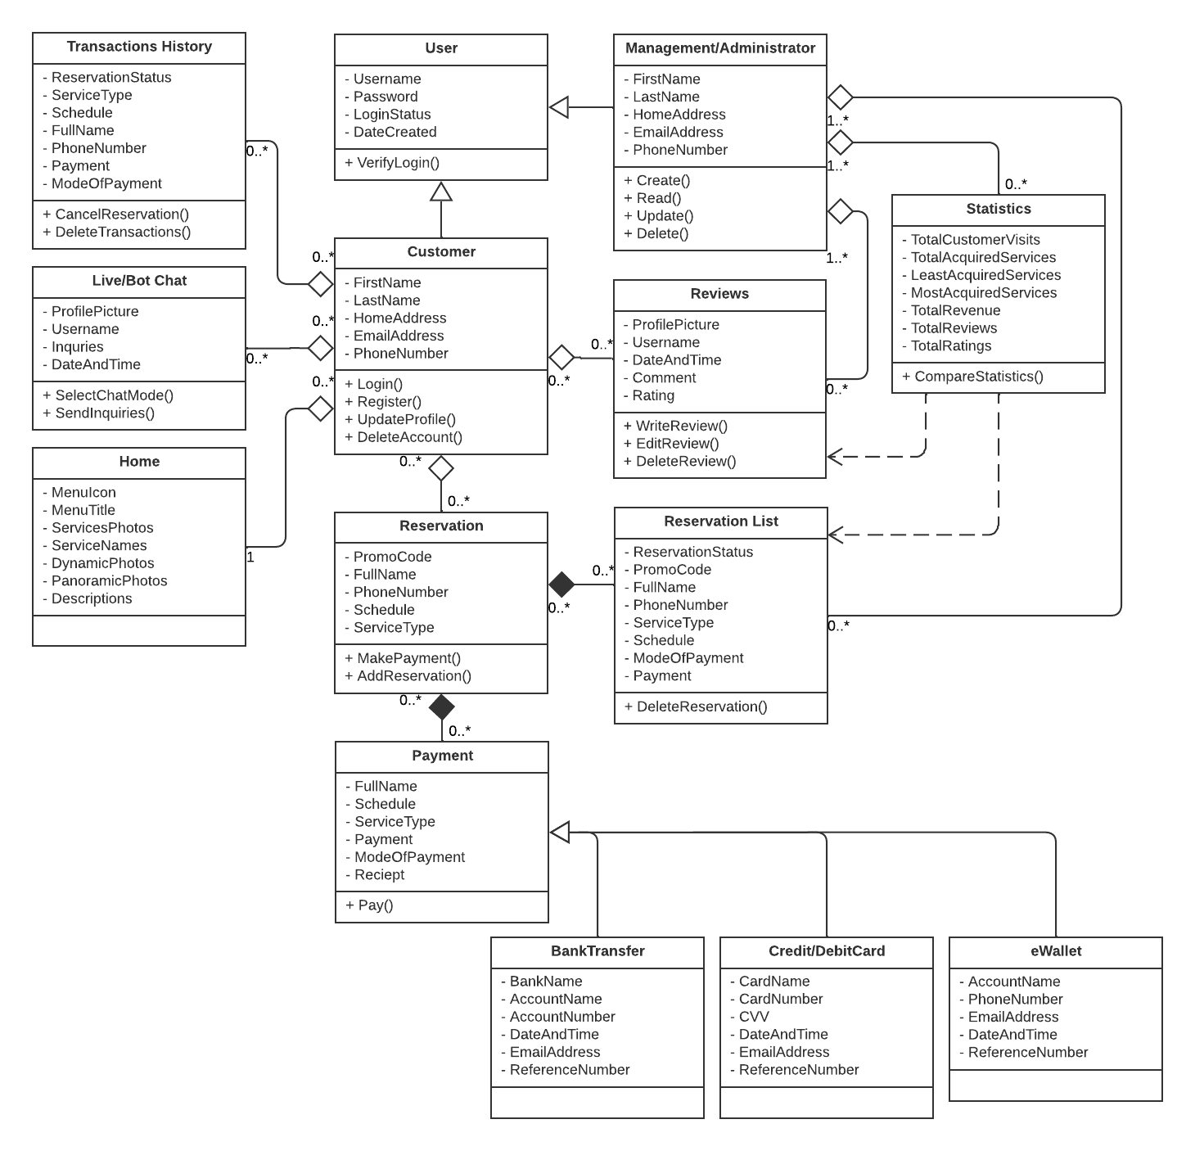
Class Diagram

Slide 34
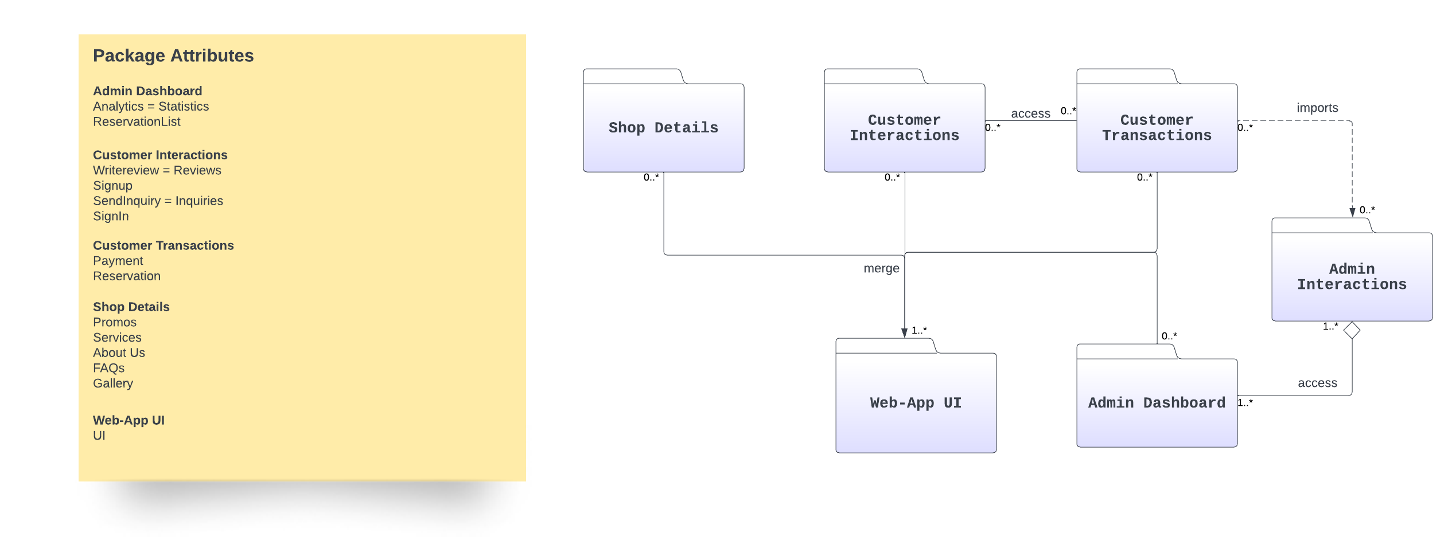
Package Diagram

Slide 35
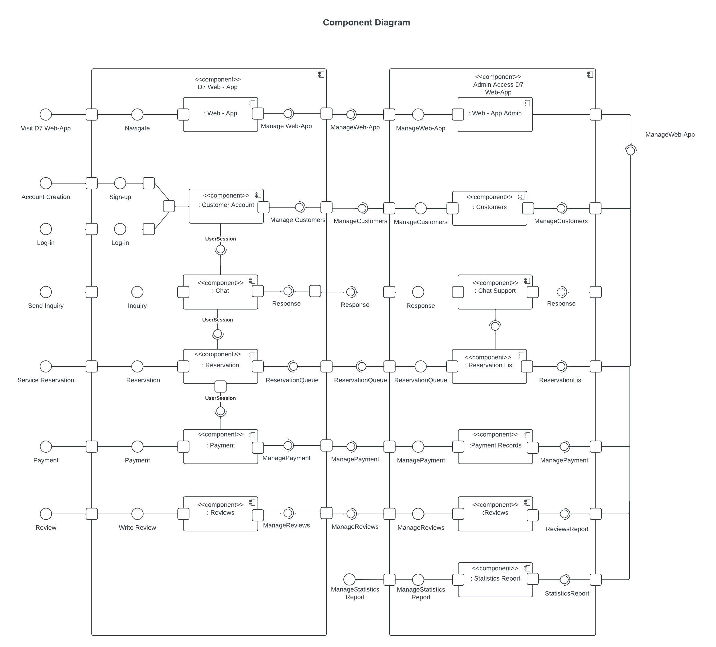

Slide 36
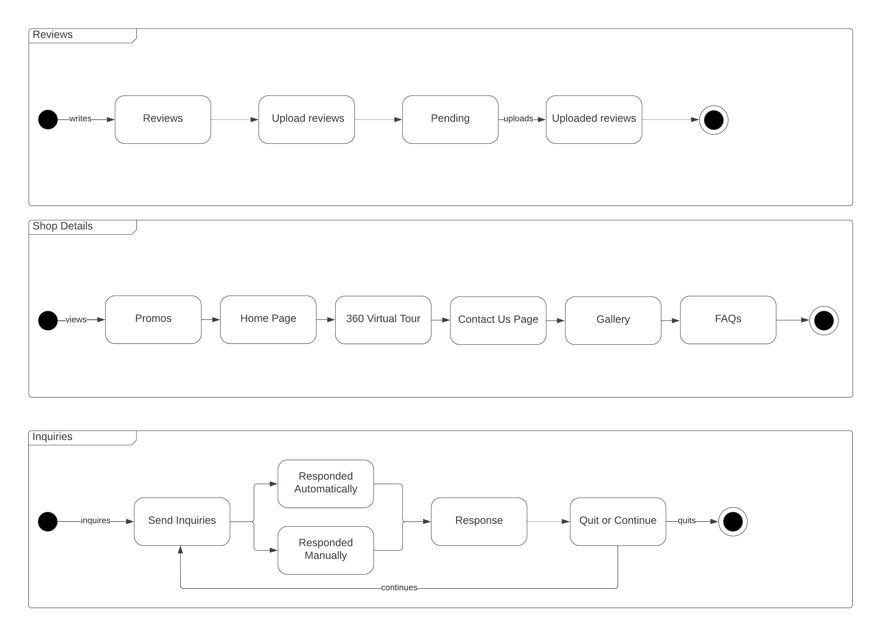
Sneak Peek
About D7 ASC
D7 Auto
Service Center
Current System
Client’s Problem
State Machine Diagram

Slide 37
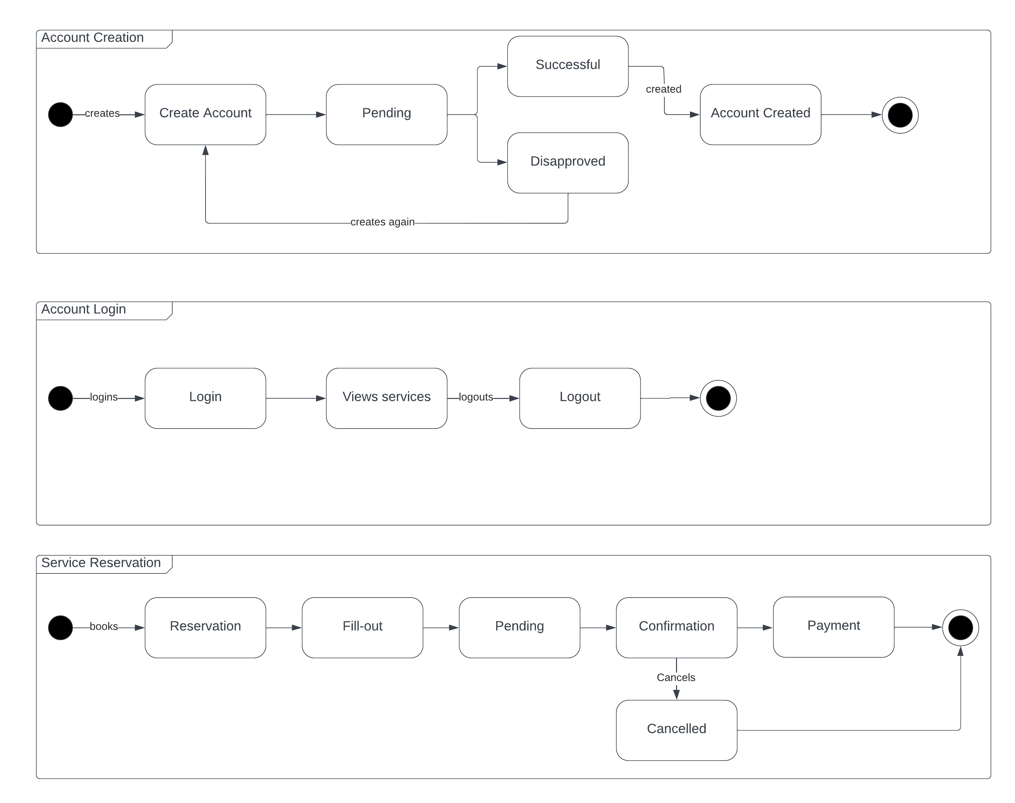
Sneak Peek
About D7 ASC
D7 Auto
Service Center
Current System
Client’s Problem
State Machine Diagram

Slide 38
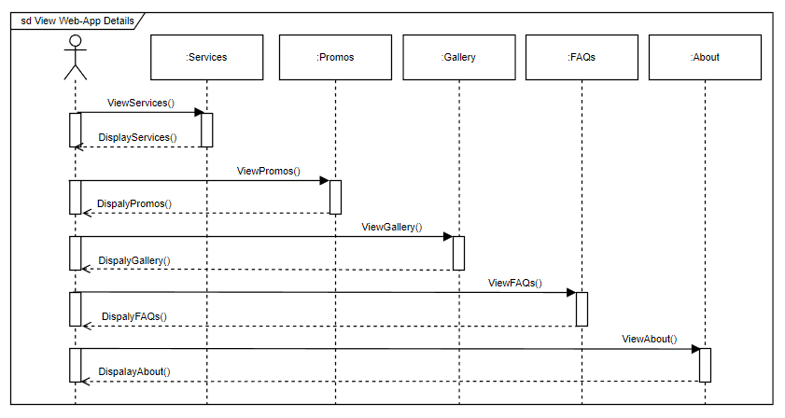
Sequence Diagram

Slide 39
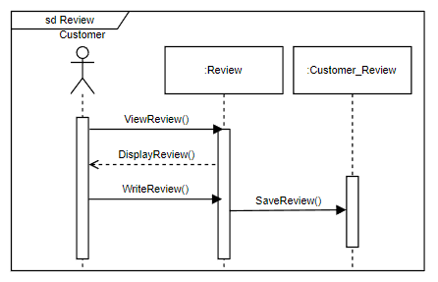

Slide 40
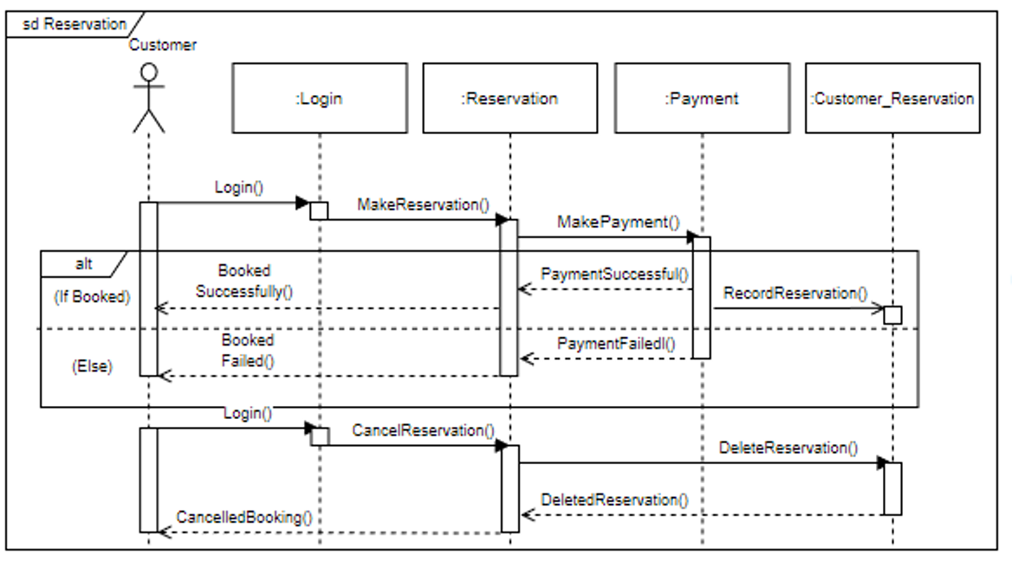

Slide 41
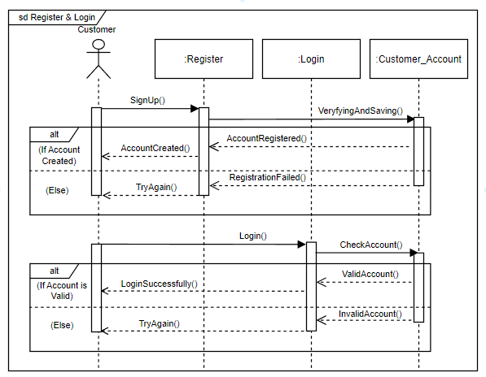

Slide 42
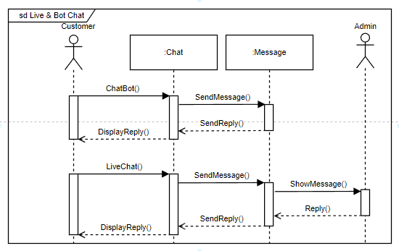

Slide 43
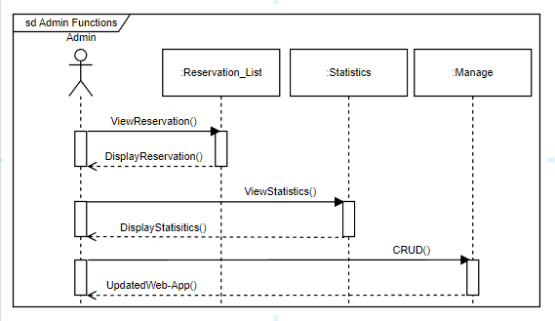

Slide 44
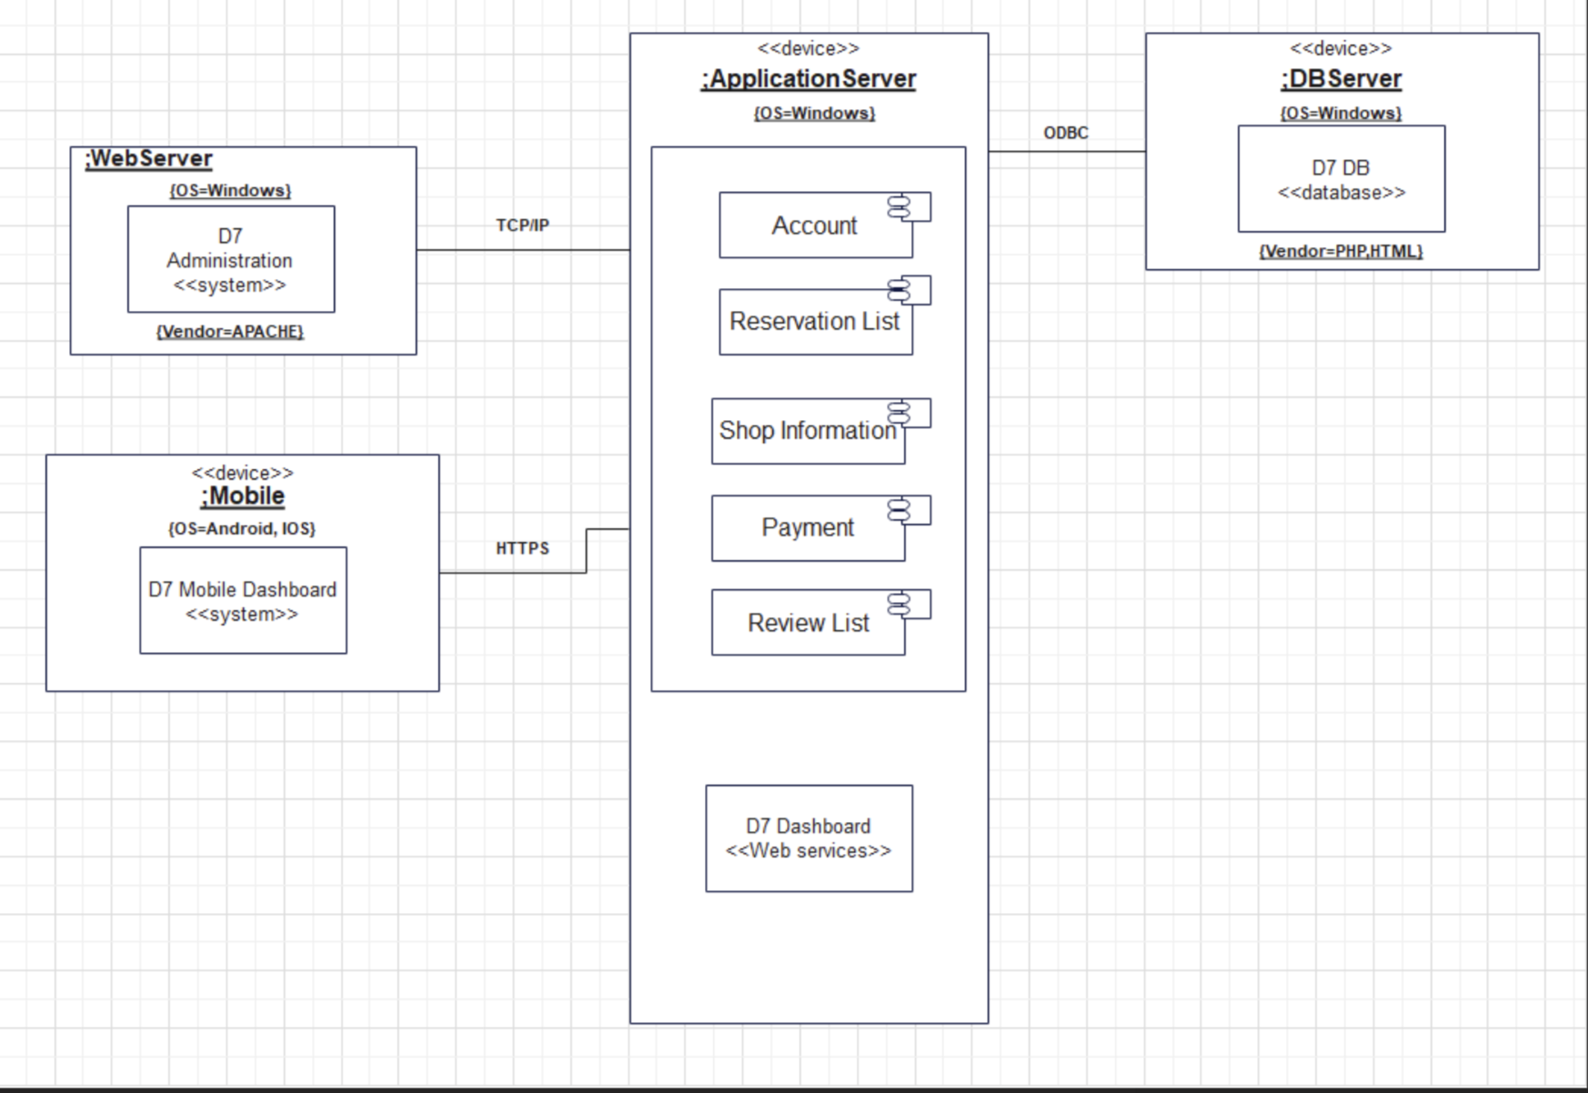
Deployment Diagram

Slide 45
Product Backlog
ID | Priority | Title | User Stories | Acceptance Criteria | Estimate
1 | Must | Account Creation | As a customer I want to be able to make an account for the web-app so that I can access the features of the web-app that requires an account. | Given the customer is on the login page when he/she clicks the <Sign Up> then he/she can create an account. | 3
2 | Must | Customer Login | As a customer I want to be able to login to the web-app so that I can make an appointment and write a review. | Given the customer is on the login page when he/she fills up the username and password correctly and clicks the <Login> then he/she will now be logged into the web-app. | 1
3 | Must | Service Reservation | As a customer I want to be able to make an appointment so that I can be free from having to wait in line to start a transaction. | Given the customer is in the reservation form and has logged in to his/her account when he/she answers the reservation form then he/she can continue to pay the fee for reservation. | 3

Slide 46
4 | Should | Inquiries | As a customer I want to be able to get an immediate response with my general inquiries so that I can receive the requested information at once. | Given the customer navigates to the bottom right of the web-app when he/she clicks the <Chat Icon> then he/she can now send inquiry. | 5
5 | Must | Reviews | As a customer I want to be able to write a review about the establishment’s services so that I can leave my reviews to help them improve their services. | Given the customer is in the review page and logged into his/her account when he/she clicks the <Write Review> then he/she can write a review. | 3
6 | Must | Shop Details | As a customer I want to be able to know more about the establishment’s available services and shop details so that I can easily decide if I want to avail themselves of their services or not. | Given the customer was able to navigate the web-ap when he/she visits the web-app then he/she can view and navigate the services and shop details. | 5

Slide 47
7 | Must | Statistics | As an Admin/Management I want to be able to view the statistics of the web-app so that I can find out if the service center is performing well. | Given the Web-App has visitors and customers when Admin/Management clicks <dashboard> then he/she can view the statistics of the web-app. | 5
8 | Must | Manage Reservation List | As an Admin/Management I want to be able to manage the reservation list of the customers so that I can find out if the customers cancel their reservations or not. | Given the Web-App has customers and makes an appointment when Admin/Management clicks the <Reservations> then he/she can manage the reservation list. | 2
9 | Must | Manage Web-App | As an Admin/Management I want to be able to Manage my web-app so that I can Add, Read, Update, and Delete any content I want in the Web-app. | Given the Admin/Management has logged into their admin account when he/she clicks the <Mange Web-App>then he/she can Create, Read, Update, and Delete any content in the web-app. | 8

Slide 48
Release Plan
 | Release Plan 1 | Release Plan2 | Release Plan 3
Customer | Account Creation Customer Login Shop Details | Reviews Service Reservation Inquiries | -
Management /Administrator | - | - | Manage Web-App Manage Reservation List Statistics

Slide 49
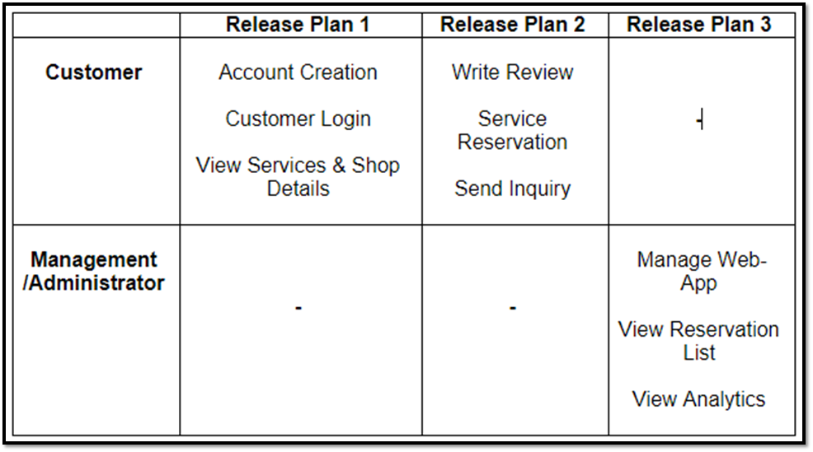
Sneak Peek
About D7 ASC
D7 Auto
Service Center
Current System
Client’s Problem

Slide 50
Sneak Peek
About D7 ASC
Current System
Client’s Problem
Elite Four
We make IT happen.

Slide 51
PPT Vectors:
<a href="https://www.freepik.com/free-vector/solidarity-concept-illustration_14562369.htm#query=team&position=2&from_view=search">Image by storyset</a> on Freepik
<a href="https://www.freepik.com/free-vector/curiosity-people-concept-illustration_29979597.htm#query=what&position=2&from_view=search">Image by storyset</a> on Freepik
<a href="https://www.freepik.com/free-vector/www-concept-illustration_8426454.htm#query=website&position=1&from_view=search">Image by storyset</a> on Freepik
. <a href="https://www.freepik.com/free-photo/black-marble-background-with-gold-lining_16018288.htm#page=2&query=gold%20marble&position=49&from_view=search&track=sph">I
mage by rawpixel.com</a> on Freepik <a href="https://www.freepik.com/free-photo/marbled-product-background_4138814.htm#query=white%20gold%20marble&position=9&from_view=search&track=sph">Image
by rawpixel.com</a> on Freepik
Video Vectors:
<a href="https://www.freepik.com/free-vector/set-modern-website-landing-page-design-templates-mobile-phone-tablet-with-gallery-articles-contact-form-flat-isolated-illustration_15480910.htm#query=website%20template&position=0&from_view=search">Image by macrovector</a> on Freepik
<a href="https://www.freepik.com/free-vector/flat-design-ui-ux-landing-page_18275093.htm#query=website%20template&position=28&from_view=search">Image by pikisuperstar</a> on Freepik
<a href="https://www.freepik.com/free-vector/flat-design-ui-ux-landing-page_18275093.htm#query=website%20template&position=28&from_view=search">Image by pikisuperstar</a> on Freepik
<a href="https://www.freepik.com/free-vector/visual-data-concept-illustration_7504550.htm#query=analytics&position=0&from_view=search">Image by storyset</a> on Freepik
<a href="https://www.freepik.com/free-vector/setup-analytics-concept-illustration_7140763.htm?query=analytics">Image by storyset</a> on Freepik
<a href="https://www.freepik.com/free-vector/data-inform-illustration-concept_6195525.htm#query=analytics&position=3&from_view=search">Image by storyset</a> on Freepik
<a href="https://www.freepik.com/free-vector/organic-flat-feedback-concept_13961232.htm#query=reviews&position=1&from_view=search">Image by pikisuperstar</a> on Freepik
<a href="https://www.freepik.com/free-vector/human-hand-holding-mobile-phone-with-text-messages_9175328.htm#query=chat&position=24&from_view=search">Image by pch.vector</a> on Freepik
<a href="https://www.freepik.com/free-vector/online-chat-customer-bot-messenger-hand-holding-mobile-phone-with-messages-from-chatbot-screen-flat-vector-illustration-artificial-intelligence-users-suppo
rt-service-concept_21684194.htm#query=bot%20chat&position=3&from_view=search">Image by pch.vector</a> on Freepik <a href="https://www.freepik.com/free-vector/organic-flat-customer-support-illustration_13184981.htm#query=live%20chat&position=1&from_view=search">Freepik</a>

